Slide 1
DRUG SUPPLY BLOCKCHAIN
Vivek Badrinarayan
Swathi Chandrashekaraiah (Northeastern University, Boston)

Slide 2
PROBLEM STATEMENT
Drug Counterfeiting is one of the most dangerous and major issues faced in today’s world.
According to World Health Organization(WHO),
an estimated 1 in 10 medications in developing and under developed countries are either falsified or substandard.
At least a 100,000 to 1 million people die every year due to counterfeit drugs.
It is estimated that at least 72,000 children die of pneumonia and 69,000 people die of malaria each year as a result of falsified or substandard treatments.
In developed countries like the U.S., the government has taken necessary measures to protect medications, but at a cost of 27 billion dollars a year.

Slide 3
OBJECTIVE
The objective of the project is to build a global communication network for protecting the drug distribution supply chain and investigating drug counterfeit crimes.
We want to make sure the drug consumed by the patients are the right drugs.
And also to make sure that every user of our application is a genuine user with a valid identity.

Slide 4

TECHNOLOGIES USED
Angular5 – Angular is a powerful frontend Javascript framework developed by Google, and possibly one of the most popular frameworks among developers.
Solidity - Solidity is a contract-oriented, high-level language for implementing smart contracts.
Web3 - This is the Ethereum compatible JavaScript API which implements the Generic JSON RPC spec.
Uport - A self-sovereign identity and user-centric data platform, enabled and secured by Ethereum.
TestRPC - TestRPC is a Node.js based Ethereum client for testing and development. It uses ethereumjs to simulate full client behavior and make developing Ethereum applications much faster.

Slide 5

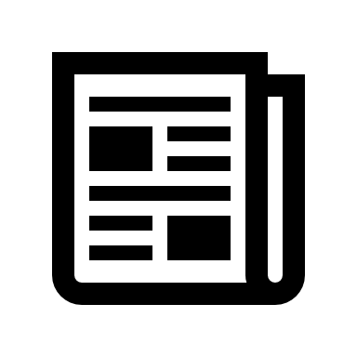
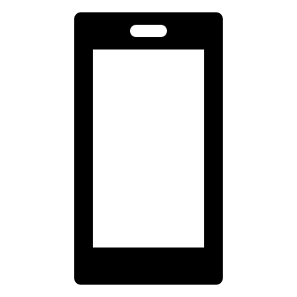
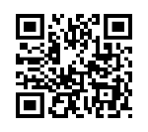

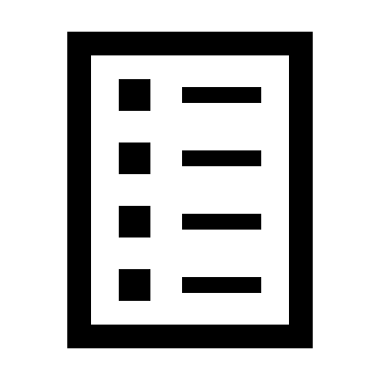
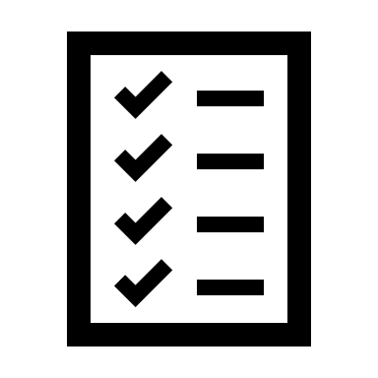
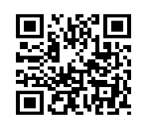


User Registration
Registration Form
Potential Users:
Manufacturer
Distributor/Supplier
Pharmacy
Please visit the Admin Office for Document Verification
New User
Scan Uport QR Code
Submit Form
Ethereum Blockchain
User Deployed on Blockchain
Attestation by Admin and Issue of Certificate to the user
System Admin
Pending Approval
User Application Form
Scan QR Code to get the certificate on the user’s phone
Document Verification
Original Documents
New User

Slide 6
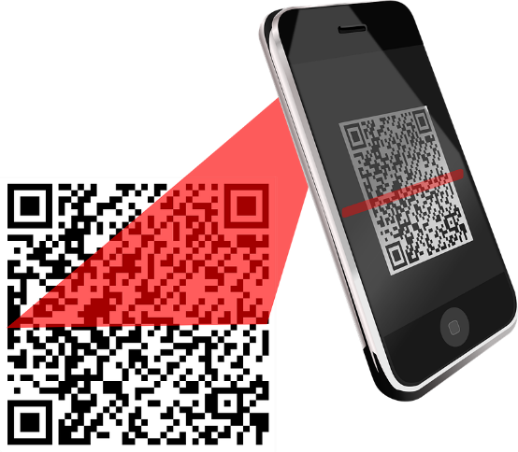
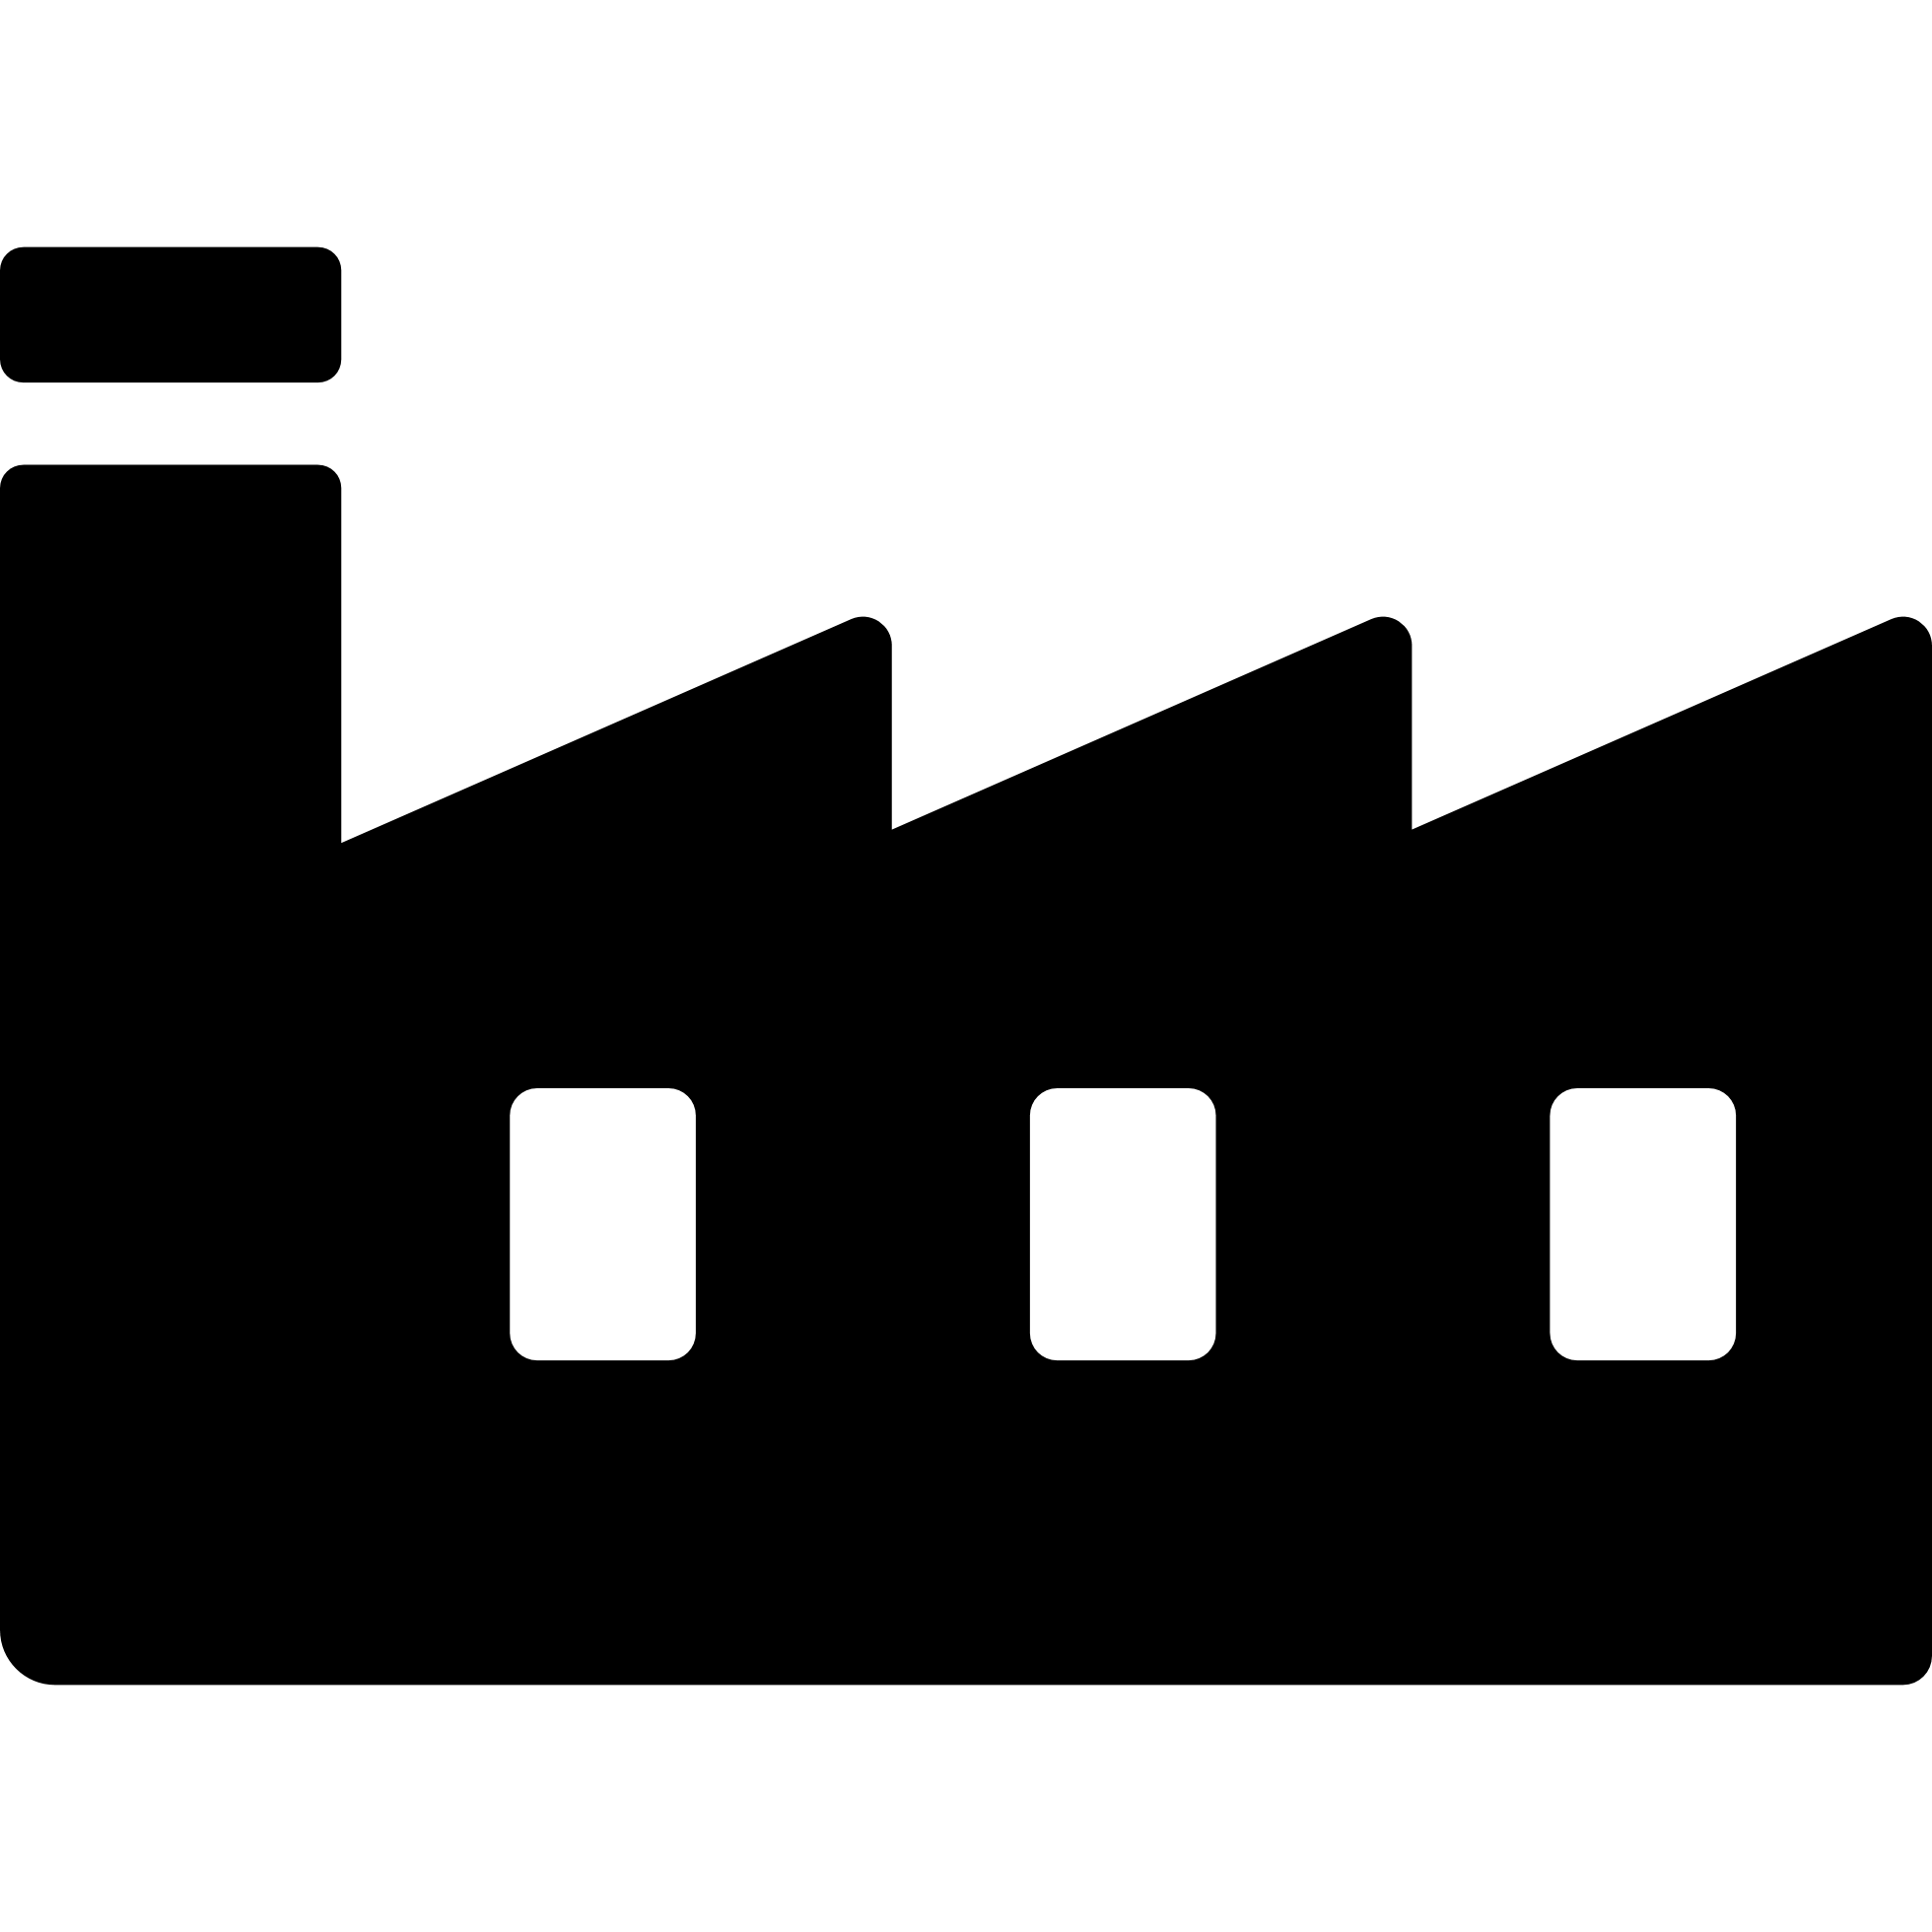
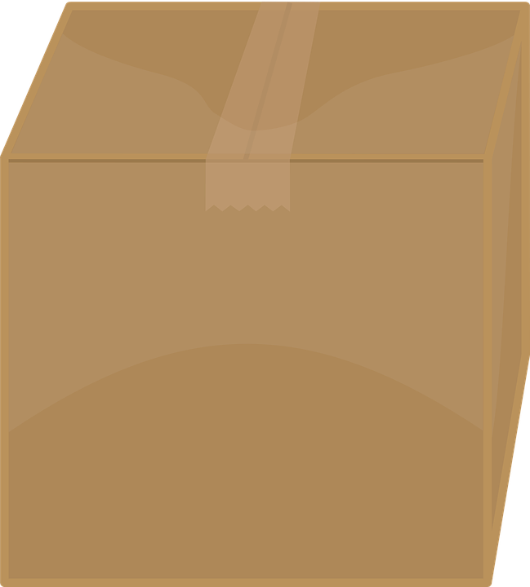
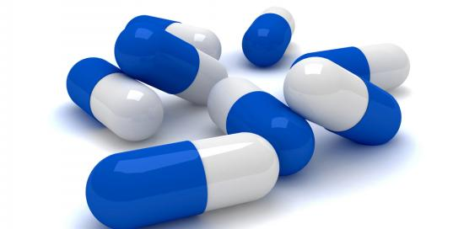
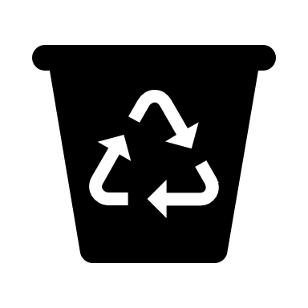
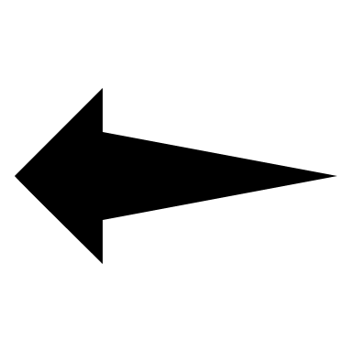
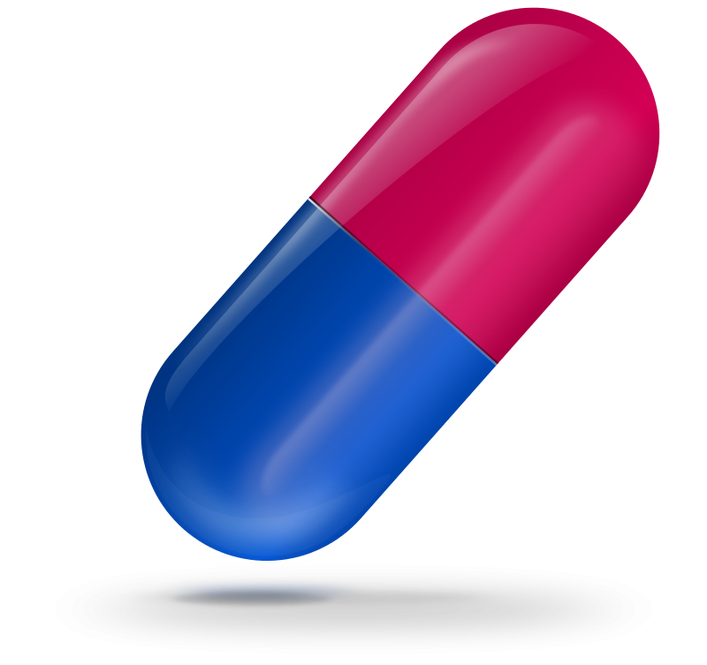

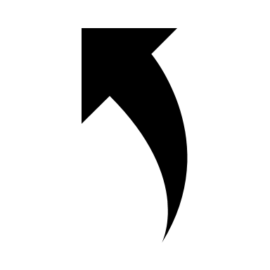

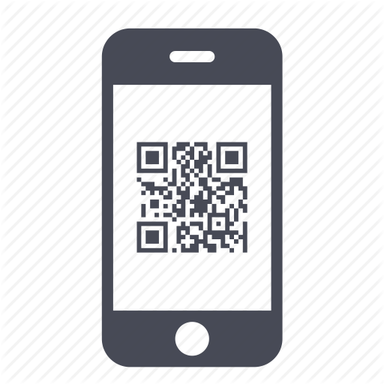


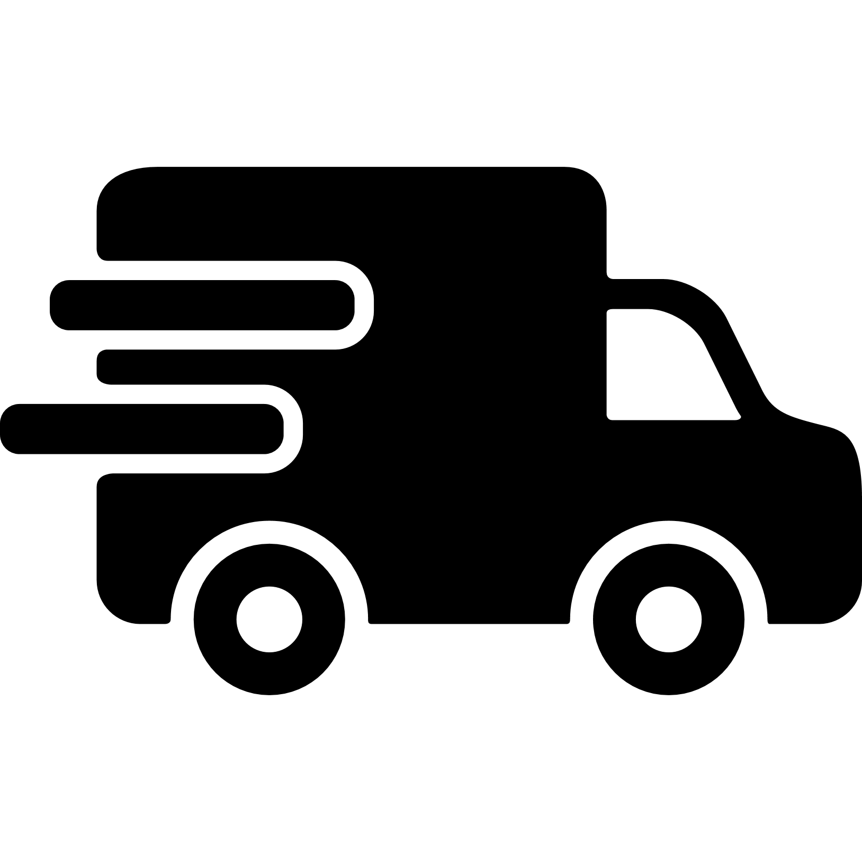
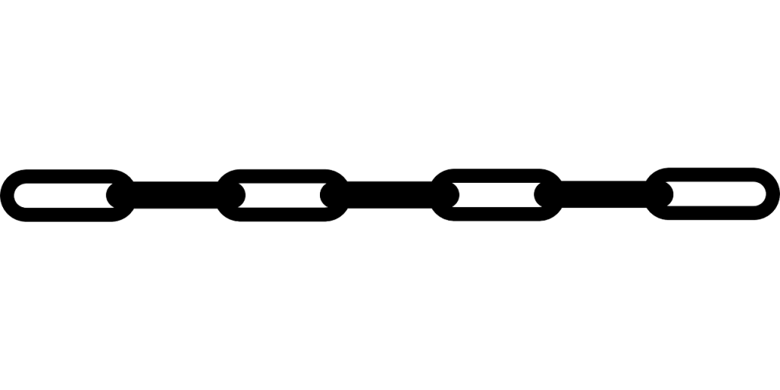
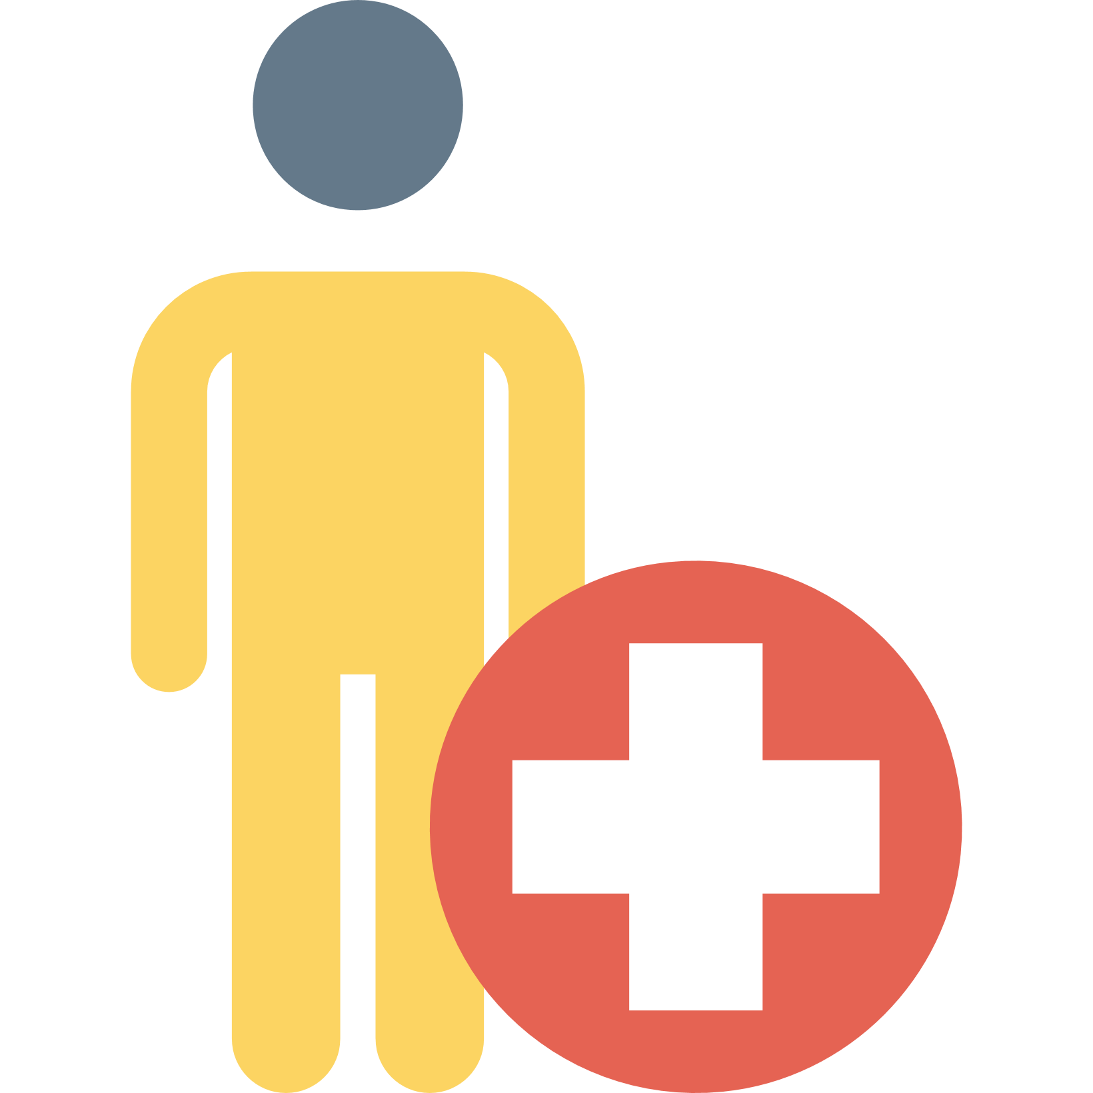
Medication Movement
Manufactures
Medication ID
Verified Manufacturer
Suspicious Medications
Fake Drug
Fake Drug
Verified Pharmacy
Verified Distributor
Verified Manufacturer
Valid Medications
Patient
Pharmacy Inventory
Distributor Inventory
Manufacturer Inventory
BLOCKCHAIN

Slide 7
Conclusion
We have successfully been able to solve
Identity issue. All players of the supply chain are genuine and verified.
The transactions are signed on the mobile phones.
Secure movement of medications using Blockchain.
Reduce the number of deaths caused due to drug counterfeiting by a very huge margin.
We can eradicate the illegal market of drug supply chain in the society.

Slide 8
Thank You ☺

